Slide 1
Computer Vision and Deep Learning
Lecture 8

Slide 2
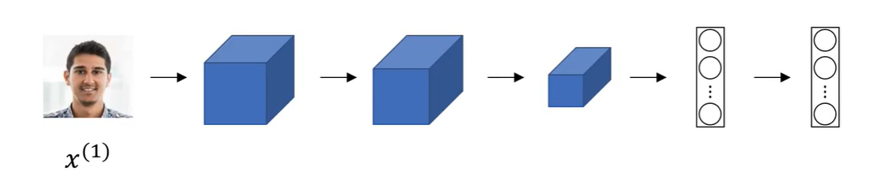
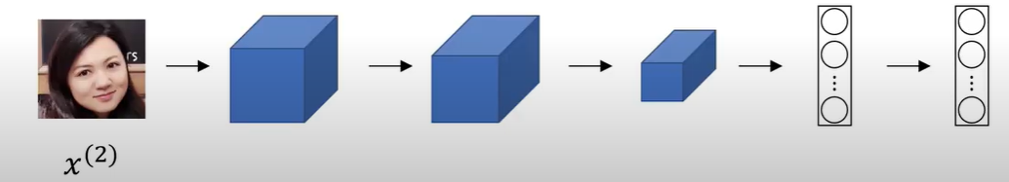
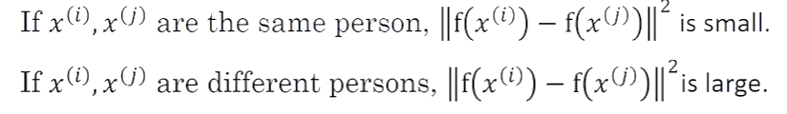
Siamese networks
Two or more inputs are encoded and the output features are compared
Example credit: Andrew Ng, deeplearning.ai, Convolutional Neural Networks

Slide 3
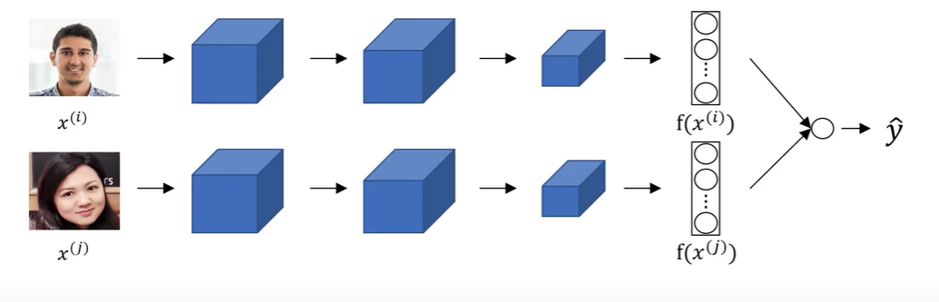
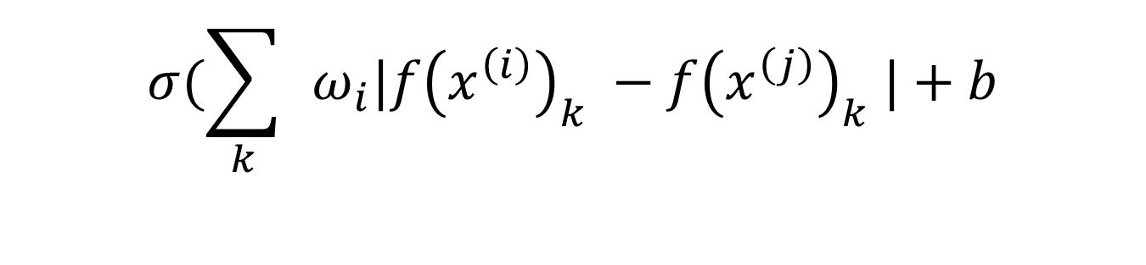
Face verification as a binary classification problem
$$σ(\sum_{k}{ }ω_{i}|f{\left(x^{\left(i\right)}\right)}_{k} −f{\left(x^{\left(j\right)}\right)}_{k} |+b$$
Example credit: Andrew Ng, deeplearning.ai, Convolutional Neural Networks

Slide 4
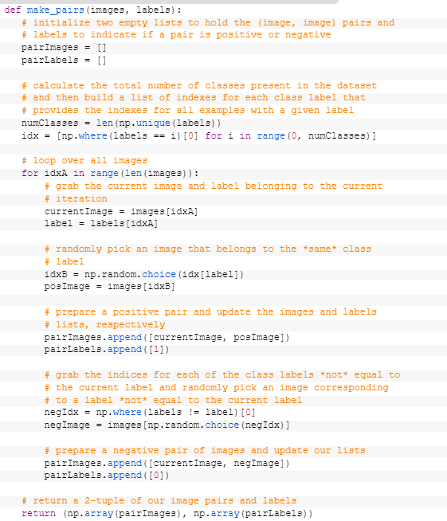
https://www.pyimagesearch.com/2020/11/30/siamese-networks-with-keras-tensorflow-and-deep-learning/

Slide 5
def build_siamese_model(inputShape, embeddingDim=48):
# specify the inputs for the feature extractor network
inputs = Input(inputShape)
# define the first set of CONV => RELU => POOL => DROPOUT layers
x = Conv2D(64, (2, 2), padding="same", activation="relu")(inputs)
x = MaxPooling2D(pool_size=(2, 2))(x)
x = Dropout(0.3)(x)
# second set of CONV => RELU => POOL => DROPOUT layers
x = Conv2D(64, (2, 2), padding="same", activation="relu")(x)
x = MaxPooling2D(pool_size=2)(x)
x = Dropout(0.3)(x)
# prepare the final outputs
pooledOutput = GlobalAveragePooling2D()(x)
outputs = Dense(embeddingDim)(pooledOutput)
# build the model
model = Model(inputs, outputs)
# return the model to the calling function
return model
https://www.pyimagesearch.com/2020/11/30/siamese-networks-with-keras-tensorflow-and-deep-learning/

Slide 6
imgA = Input(shape=config.IMG_SHAPE)
imgB = Input(shape=config.IMG_SHAPE)
featureExtractor = build_siamese_model(config.IMG_SHAPE)
featsA = featureExtractor(imgA)
featsB = featureExtractor(imgB)
distance = Lambda(utils.euclidean_distance)([featsA, featsB])
outputs = Dense(1, activation="sigmoid")(distance)
model = Model(inputs=[imgA, imgB], outputs=outputs)
model.compile(loss="binary_crossentropy", optimizer="adam",
metrics=["accuracy"])
# train the model
print("[INFO] training model...")
history = model.fit(
[pairTrain[:, 0], pairTrain[:, 1]], labelTrain[:],
validation_data=([pairTest[:, 0], pairTest[:, 1]], labelTest[:]),
batch_size=config.BATCH_SIZE,
epochs=config.EPOCHS)
https://www.pyimagesearch.com/2020/11/30/siamese-networks-with-keras-tensorflow-and-deep-learning/

Slide 7
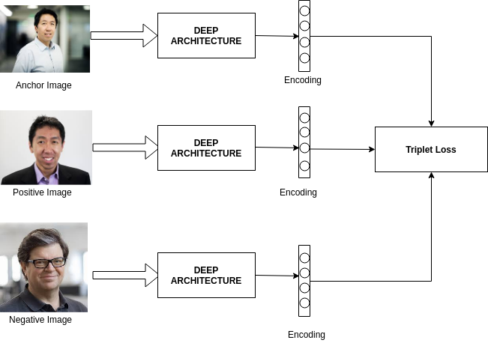
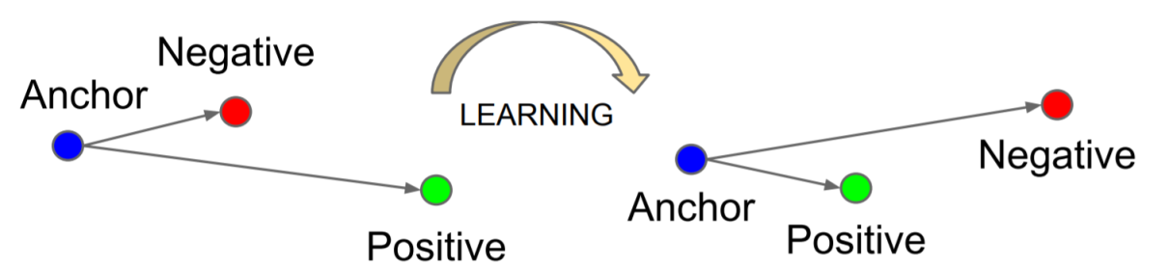
Triplet loss
TRIPLETS:
Anchor
Positive
Negative

Slide 8
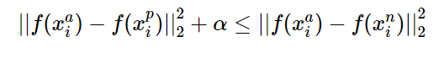
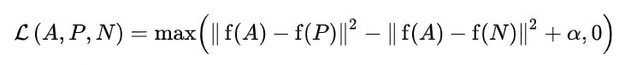
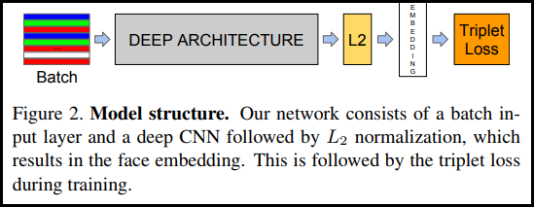
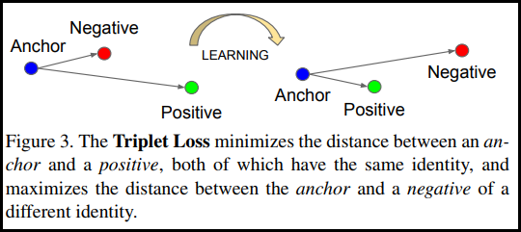
Triplet loss

Slide 9
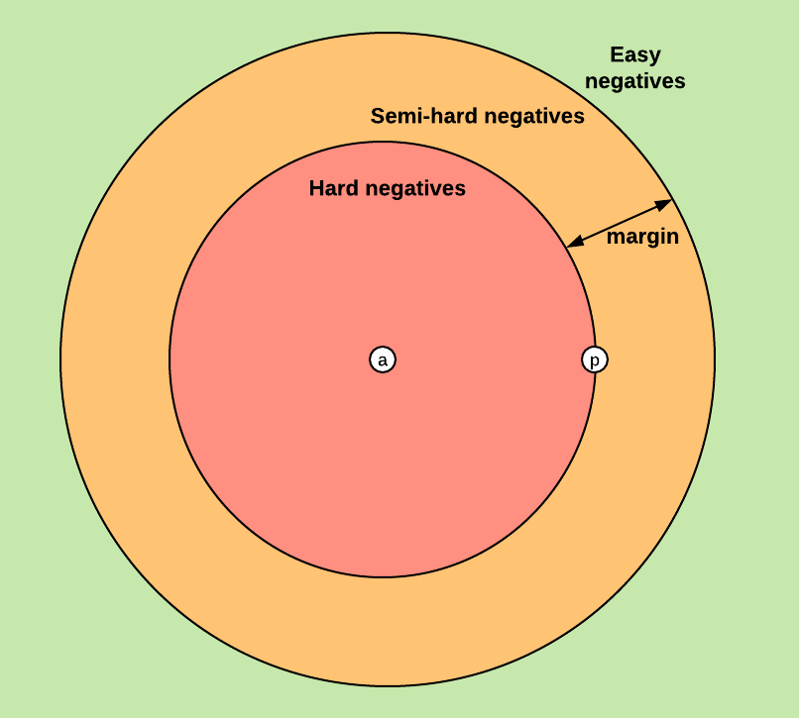
Triplet selection
Offline triplet mining
Online triplet mining
Batch all
Batch hard
https://omoindrot.github.io/triplet-loss

Slide 10
Online triplet mining
batch of faces as input of size B=PK, composed of P different persons with K images each
batch all: select all the valid triplets, and average the loss on the hard and semi-hard triplets
this produces a total of PK(K−1)(PK−K) triplets (PK anchors, K−1 possible positives per anchor, PK−K possible negatives)
batch hard: for each anchor, select the hardest positive (biggest distance d(a,p)) and the hardest negative among the batch
this produces PK triplets

Slide 11
Training neural nets
http://karpathy.github.io/2019/04/25/recipe/
https://www.youtube.com/watch?v=NUmbgp1h64E
https://www.youtube.com/watch?v=SjQyLhQIXSM&list=PLkDaE6sCZn6Hn0vK8co82zjQtt3T2Nkqc&index=2
https://www.youtube.com/watch?v=C1N_PDHuJ6Q&list=PLkDaE6sCZn6Hn0vK8co82zjQtt3T2Nkqc&index=3

Slide 13
Computer vision tasks

Slide 14
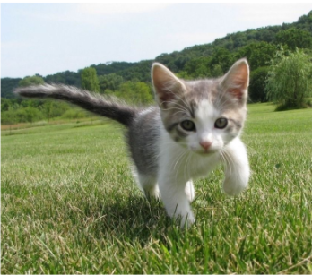
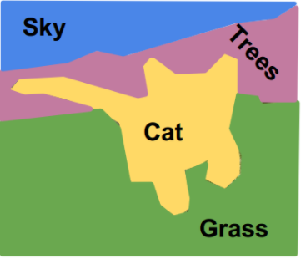
Computer vision tasks
Classification
What object is in this image?
CAT
Semantic segmentation
What label has each pixel?
Pixel level, we are not interested in objects
https://tariq-hasan.github.io/concepts/computer-vision-semantic-segmentation/

Slide 15
Computer vision tasks
Object localization
What object is in this image and where is it located?
CAT

Slide 16
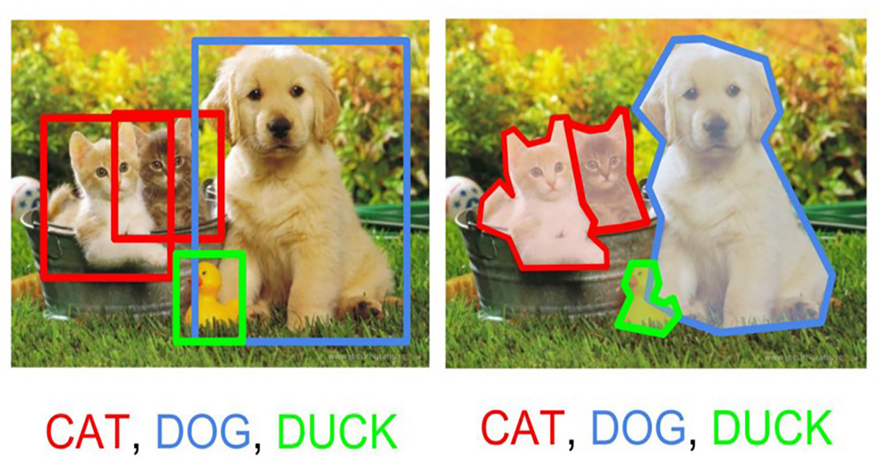
Computer vision tasks
Object detection: multiple objects
(the label and position - bounding box - of each object)
Instance segmentation: multiple objects
(the label and position of each object)
Image source: https://static.artfido.com/2018/05/cover-12.jpg

Slide 17
Semantic segmentation
Understating the image at pixel level: each pixel is labelled individually with a class
Groups both semantics and location
Global information: WHAT?
Local information: WHERE?

Slide 18
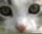
Semantic segmentation Naïve approach – sliding window
Image patch
CNN
CAT
Classify central pixel
Slide window over the input image and classify each image patch using a CNN
https://papers.nips.cc/paper/2012/file/459a4ddcb586f24efd9395aa7662bc7c-Paper.pdf

Slide 19
Semantic segmentation Naïve approach – sliding window
Image patch
CNN
CAT
Classify central pixel
Slide window over the input image and classify each image patch using a CNN
Highly inefficient!!

Slide 20
Let’s design a CNN to classify all pixels at once!
How would we encode the output (we need to output a class label for each pixel)?
What would be the input and the output size of this network?
Fully convolutional neural networks

Slide 21
Fully convolutional neural networks
The output should have the same spatial size as the input
H
FCN
H
C
W
W
Output depth:
Number of classes

Slide 22
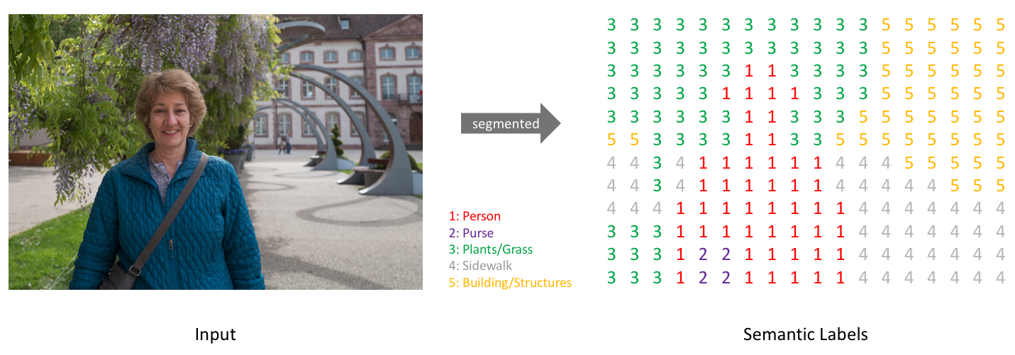
https://www.jeremyjordan.me/semantic-segmentation/#loss

Slide 23
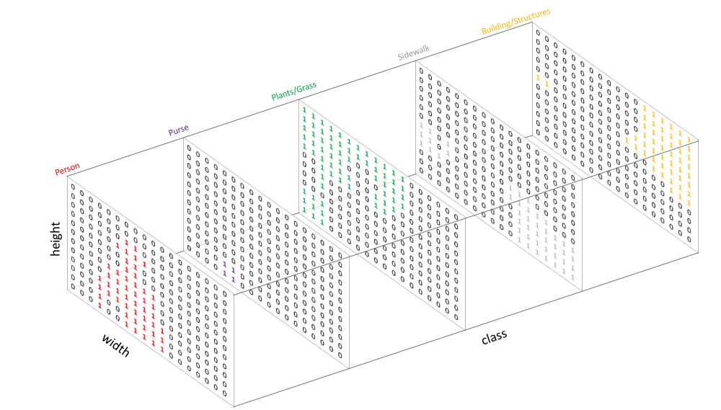

Slide 24
Output layer
Apply cross entropy pixel-wise on the last layer of the network
0 | 0
0 | 1
Class 0
2 | 1
1 | 0
0 | 1
1 | 0
Ground truth label image
Class 1
1 | 0
0 | 0
3 classes (0, 1, 2)
One hot encodings
2 – [0, 0, 1]
1 – [0, 1, 0]
0 – [1, 0, 0]
Class 2

Slide 25
Fully convolutional neural networks (FCN)
How to preserve the spatial size of the output map (input size must be equal to the output size)?

Slide 26
Fully convolutional neural networks
How to preserve the spatial size of the output map (input size must be equal to the output size)?
Don’t use any layers that reduce the spatial size

Slide 27
Fully convolutional neural networks
How to preserve the spatial size of the output map (input size must be equal to the output size)?
Don’t use any layers that reduce the spatial size -> inefficient
Use two paths in the network: a down-sampling and an up-sampling path

Slide 28
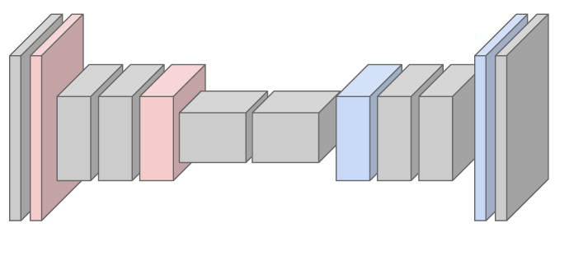
Fully convolutional neural networks
Down-sampling: strided convolutions, pooling layers
Down sampling layers
Up-sampling layers
Up-sampling: NN, bilinear interpolation, max unpooling, transposed convolution

Slide 29
Up-sampling techniques

Slide 30
Up-sampling Nearest neighbour
4 | 4 | 5 | 5
4 | 4 | 5 | 5
10 | 10 | 20 | 20
10 | 10 | 20 | 20
4 | 5
10 | 20
2x2
4x4

Slide 31
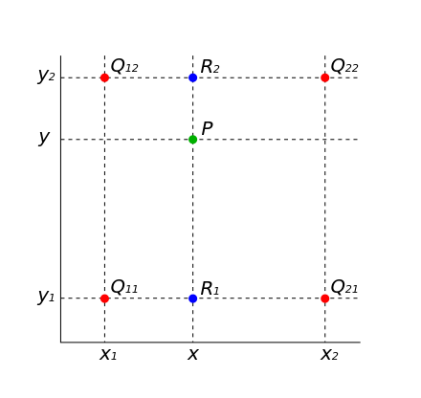
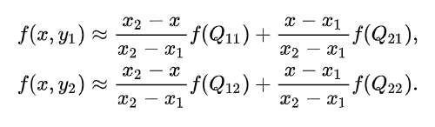
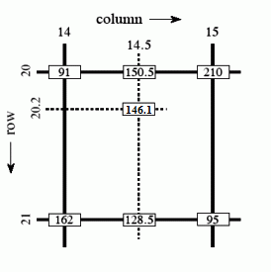
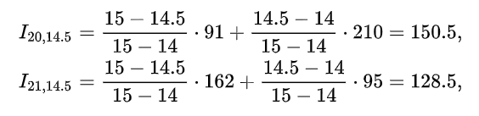
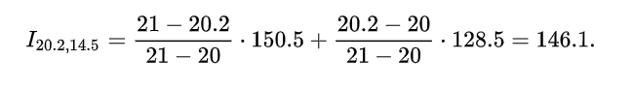
Up-sampling Bilinear interpolation

Slide 32
Up-sampling Bilinear interpolation
10 | 12.5 | 17.5 | 20
15 | 17.5 | 22.5 | 25
25 | 27.5 | 32.5 | 35
30 | 32.5 | 37.5 | 40
10 | 20
30 | 40
2x2
4x4

Slide 33
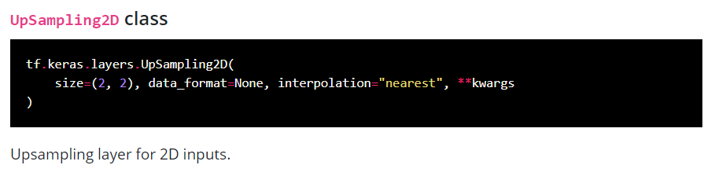
Up-sampling in keras
Interpolation:
- nearest
- bilinear

Slide 34
Max un-pooling
Symmetric structure of the FCN
1 | 4 | 3 | 1
2 | 3 | 5 | 2
10 | 9 | 2 | 3
7 | 3 | 4 | 20
0 | 4 | 0 | 0
0 | 0 | 5 | 0
10 | 0 | 0 | 0
0 | 0 | 0 | 20
4 | 5
10 | 20
……
Pooling: remember the position of the maximum element within the receptive field of the layer
Max Un-Pooling: use the position of the max
DOWNSAMPLING PATH
UP-SAMPLING PATH

Slide 35
Transposed convolutions Learnable up-sampling
Remember strided convolutions
3x3, stride 2, pad 1

Slide 36
Transposed convolutions Learnable up-sampling
Remember strided convolutions
3x3, stride 2, pad 1

Slide 37
Transposed convolutions Learnable up-sampling
Remember strided convolutions
3x3, stride 2, pad 1

Slide 38
Transposed convolutions Learnable up-sampling
Remember strided convolutions
3x3, stride 2, pad 1

Slide 39
Transposed convolutions Learnable up-sampling
NOW: transposed convolutions
filter
i1
The input feature i1 is multiplied with the filter values
i1 is like a weight for the filter value.
Copy the “weighted” filter in the corresponding output
3x3, stride 2, pad 1

Slide 40
Transposed convolutions Learnable up-sampling
Where there is overlap, sum up the values
NOW: transposed convolutions
filter
 | i2
The input feature i2 is multiplied with the filter values
i2 is like a weight for the filter value.
Copy the “weighted” filter in the corresponding output
3x3, stride 2, pad 1

Slide 41
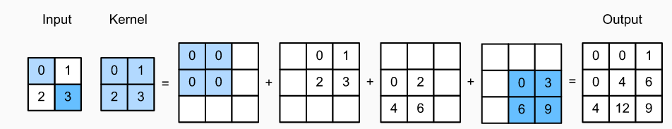
Transposed convolutions Learnable up-sampling
The weights of the filter are learned
At each position multiply the filter values with the corresponding position of the input layer to get the result of the output
Add overlapping positions
Example: 1 stride and 0 padding

Slide 42
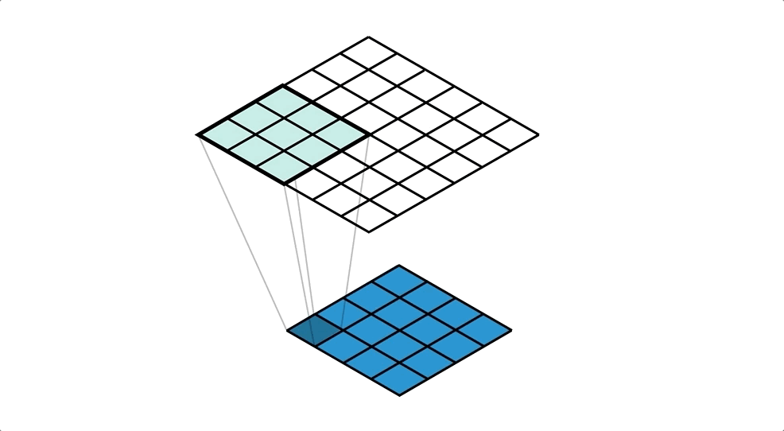
Transposed convolutions Learnable up-sampling
Image source: https://medium.com/apache-mxnet/transposed-convolutions-explained-with-ms-excel-52d13030c7e8

Slide 43
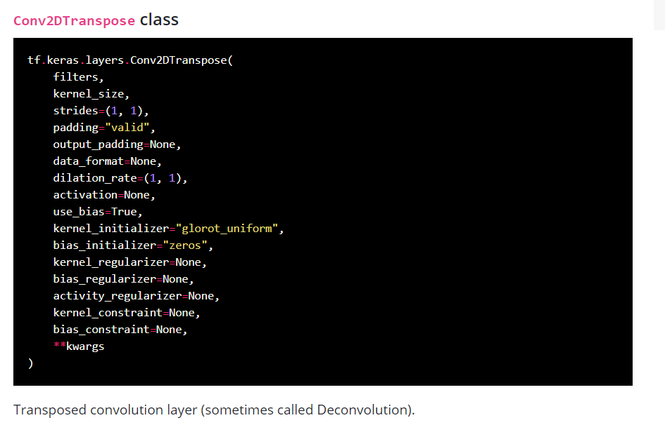
Transposed convolutions in keras

Slide 44
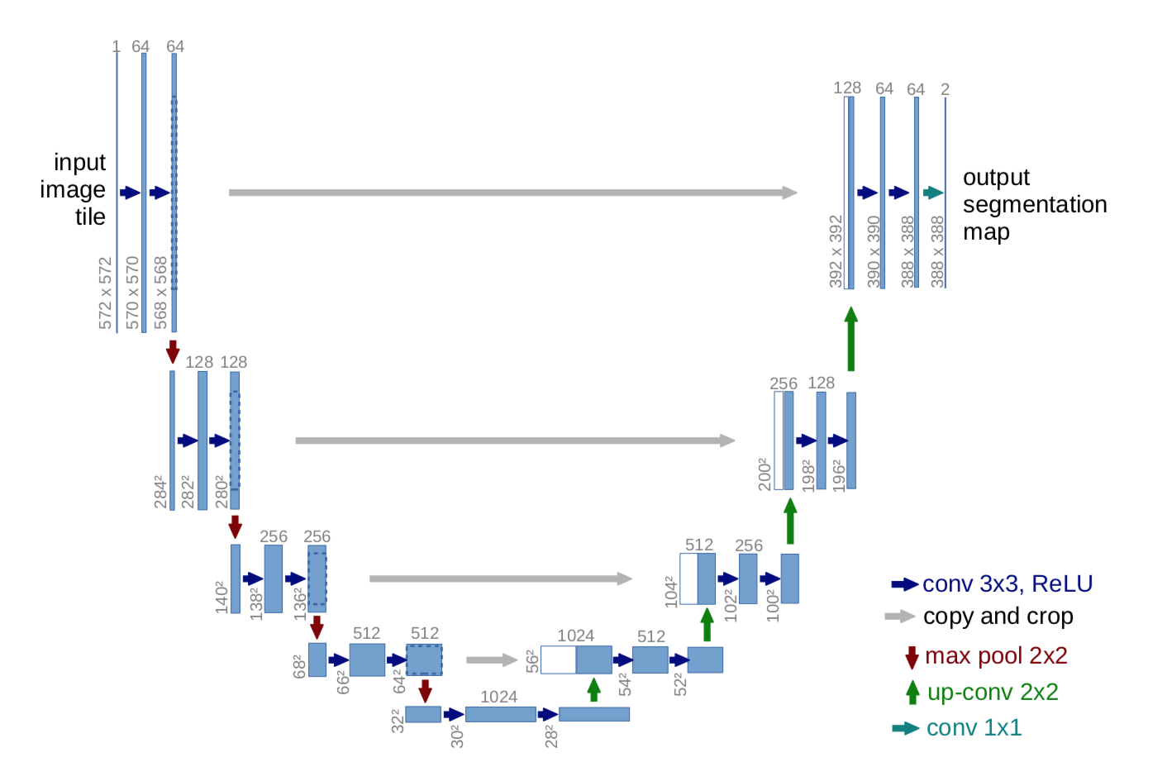
U-Net, 2015
Skip connections to help the upsampling path recover spatially detailed information from the downsampling path

Slide 45
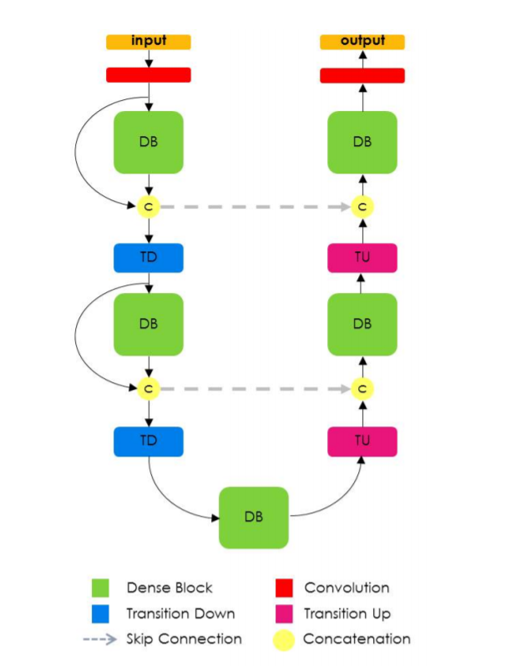
100 layers tiramisu, 2017
Similar to U-Net
uses Dense Block for convolutions and transposed convolutions
The one hundred layers tiramisu: Fully convolutional densenets for semantic segmentation, 2016

